Slide 1
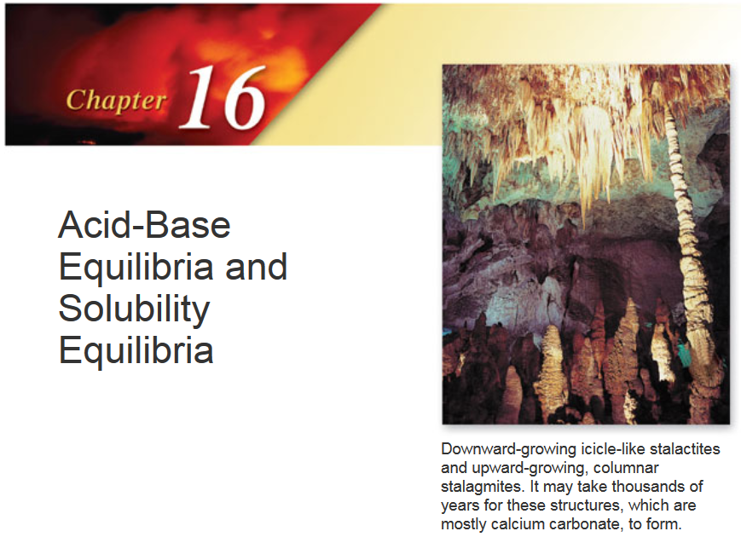

Slide 2
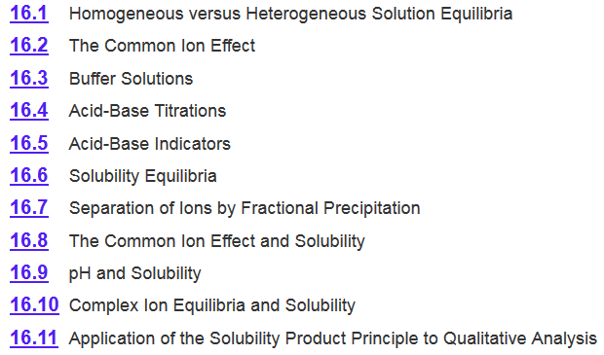
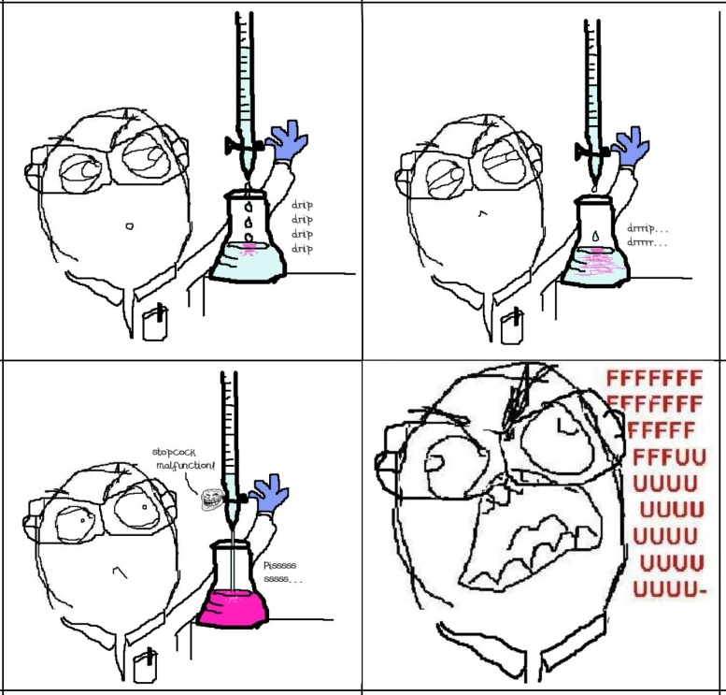
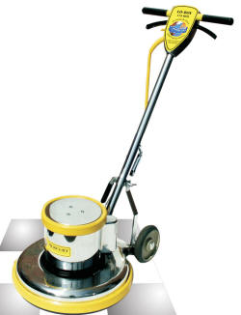
Chapter 16

Slide 3
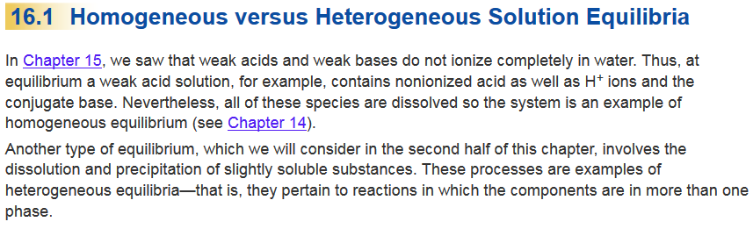
Chapter 16.1

Slide 4
Chapter 16

Slide 5
pH of a Solution
0.2 M
K_{a} = 1.8 x 10⁻⁵
CH₃COOH (aq) H⁺ (aq) + CH₃COO⁻ (aq)
 | AcOH(aq) |  | H⁺(aq) + | Ac⁻(aq)
Initial (M):
Change (M):
Equilibrium (M):
0.2
0.00
0.00
-x
+x
+x
0.2 - x
x
x
[H⁺] = 1.9 x 10⁻³ M
pH = -log (1.9 x 10⁻³ ) = 2.72
What happens to the pH if I add 0.30 M CH₃COONa?
Common Ion Effect!

Slide 6
Common Ion Effect
The common ion effect is the shift in equilibrium caused by the addition of a compound having an ion in common with the dissolved substance.
Specific case of LCP
CH₃COOH (aq) H⁺ (aq) + CH₃COO⁻ (aq)
Then we add some CH₃COONa (a strong electrolyte).
common ion
CH₃COONa (s) Na⁺ (aq) + CH₃COO⁻(aq)
The presence of a common ion suppresses the ionization of a weak acid or a weak base. It will influence the pH.
What is the pH if I add 0.30 M CH₃COONa?

Slide 7
16.1
Calculate the pH of a 0.20 M CH₃COOH solution.
(b) What is the pH of a solution containing both 0.20 M CH₃COOH and 0.30 M CH₃COONa? The K_{a} of CH₃COOH is 1.8 x 10⁻⁵.
(2.72)
0.20 M
?
 | CH₃COOH(aq) |  | H⁺(aq) + | CH₃COO⁻(aq)
CH₃COONa(aq) → Na⁺(aq) + CH₃COO⁻(aq)
0.30 M 0.30 M

Slide 8
16.1
(2.72)
Calculate the pH of a 0.20 M CH₃COOH solution.
(b) What is the pH of a solution containing both 0.20 M CH₃COOH and 0.30 M CH₃COONa? The K_{a} of CH₃COOH is 1.8 x 10⁻⁵.
 | CH₃COOH(aq) |  | H⁺(aq) + | CH₃COO⁻(aq)
Initial (M):
Change (M):
Equilibrium (M):
0.20
0
0.30
-x
+x
+x
0.20-x
x
0.30+x
[0.2]
K_{a}
If > 400
x = [H⁺] = 1.2 x 10⁻⁵ M
we can neglect x
-log (1.2 x 10⁻⁵ ) = 4.92

Slide 9
16.1
(2.72)
Calculate the pH of a 0.20 M CH₃COOH solution.
(b) What is the pH of a solution containing both 0.20 M CH₃COOH and 0.30 M CH₃COONa? The K_{a} of CH₃COOH is 1.8 x 10⁻⁵.
(4.92)
CH₃COOH (aq) H⁺ (aq) + CH₃COO⁻ (aq)
Then we add some CH₃COONa (a strong electrolyte).
common ion
CH₃COONa (s) Na⁺ (aq) + CH₃COO⁻(aq)
H⁺
pH
There is an easier way to calculate the pH for a common ion solution!

Slide 10
HH equation
Consider mixture of weak acid HA and salt NaA.
[H⁺][A⁻]
HA (aq) H⁺ (aq) + A⁻ (aq)
K_{a} =
[HA]
NaA (s) Na⁺ (aq) + A⁻ (aq)
K_{a} [HA]
[H⁺] =
[A⁻]
Henderson-Hasselbalch equation
[HA]
-log [H⁺] = -log K_{a} - log
[A⁻]
[conjugate base]
pH = pK_{a} + log
[A⁻]
[acid]
-log [H⁺] = -log K_{a} + log
[HA]
[A⁻]
pH = pK_{a} + log
pK_{a} = -log K_{a}
[HA]
Assumption: that the [A⁻] from NaA >> [A⁻] from HA

Slide 11
16.1
(2.72)
Calculate the pH of a 0.20 M CH₃COOH solution.
(b) What is the pH of a solution containing both 0.20 M CH₃COOH and 0.30 M CH₃COONa? The K_{a} of CH₃COOH is 1.8 x 10⁻⁵.
CH₃COOH (aq) H⁺ (aq) + CH₃COO⁻ (aq)
Then we add some CH₃COONa (a strong electrolyte).
CH₃COONa (s) Na⁺ (aq) + CH₃COO⁻(aq)
[A⁻]
pH = pK_{a} + log
[HA]
[0.30]
pH = -log (1.8 x 10⁻⁵) + log
= 4.92
[0.20]

Slide 12
Chapter 16

Slide 13
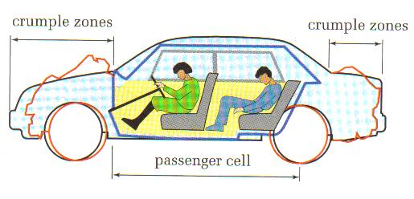
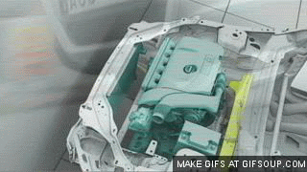
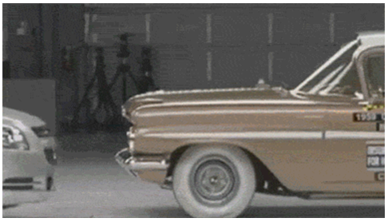
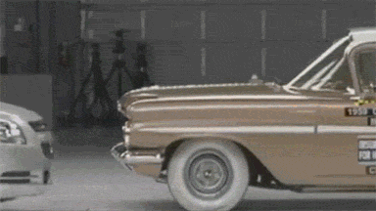
Crumple Zones
Sacrificial portion of the car that protects the passengers.
“They don’t make em’ like they use to!”
2000 Chevrolet Malibu vs. 1959 Chevrolet Bel Air (30 mph)
Buffer- the chemical equivalent to a crumple zone.

Slide 14
Buffer Solutions
A buffer solution consists of:
A weak acid (or weak base)
and
2. The salt of the weak conjugate base (or weak acid)
Both must be present!
HA (or B⁻)
A⁻ (or BH)
If there is a high concentration of A⁻ and HA, the buffer solution has the ability to resist changes in pH upon the addition of small amounts of either strong acids or bases.
The presence of a conjugate acid-base pair of a weak acid “ties up” small amounts of H⁺ or OH– ions added to the solution.

Slide 15
Buffer Solutions

Slide 16
Buffer Solutions
Without Buffer
+ HCl
H⁺
[HCl] = [H⁺]
H⁺
+ NaOH
OH⁻
[NaOH] = [OH⁻]
OH⁻
Without Buffer
A–(aq) + H⁺(aq) ⎯→ HA(aq)
[HCl] > [H⁺]
Some tied up as HA
+ HCl
HA
AH
HA
A⁻
AH
HA
HA
A⁻
HA
+ NaOH
A⁻
HA(aq) + OH–(aq) ⎯→
A–(aq) + H₂O(l)
A⁻
HA
A⁻
A⁻
HA
[NaOH] > [OH⁻]
Some tied up as H₂O
A⁻
A⁻
A⁻

Slide 17
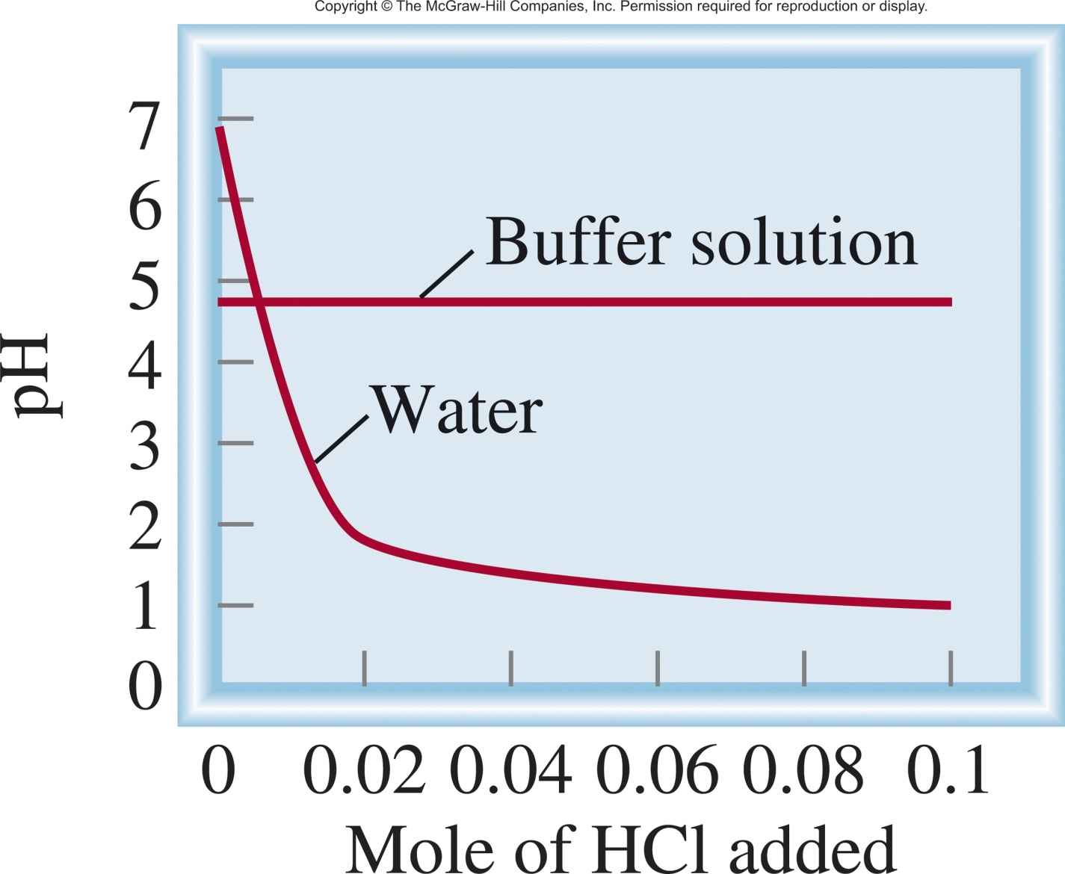
Buffer Solutions
Adding HCl:
Water
vs.
Buffer w/
1.0 M CH₃COOH
1.0 M CH₃COONa
In Water
If you add enough HCl, all of the CH₃COO⁻ will be consumed.
HCl ⎯→ H⁺ + Cl⁻ Wins!
HCl(aq) H⁺(aq) + Cl⁻(aq)
In Buffer
H⁺ (aq) + CH₃COO⁻ (aq) CH₃COOH (aq)

Slide 18
16.2
Which of the following solutions can be classified as buffer systems?
(a) KH₂PO₄/H₃PO₄
(b) NaClO₄/HClO₄
(c) C₅H₅N/C₅H₅NHCl
Conjugate acid-base?
Weak acid/weak base?

Slide 19
16.2
Which of the following solutions can be classified as buffer systems?
(a) KH₂PO₄/H₃PO₄
(b) NaClO₄/HClO₄
(c) C₅H₅N/C₅H₅NHCl
H₃PO₄ is a weak acid, and its conjugate base, H₂PO₄⁻,is a weak base. It is a buffer.
HClO₄ is a strong acid, its conjugate base, ClO₄⁻, is an extremely weak base. It is not a buffer.
C₅H₅N is a weak base and its conjugate acid, C₅H₅N⁺H , is a weak acid. Therefore, this is a buffer system.

Slide 20
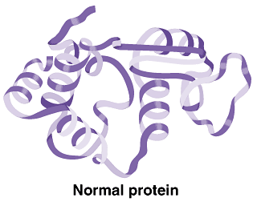

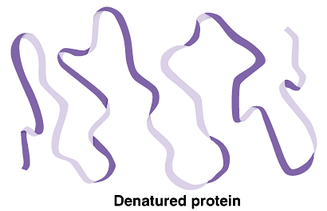




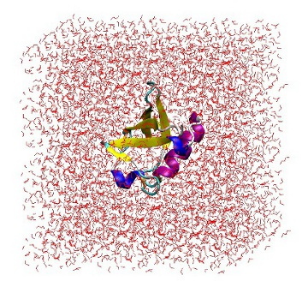
Crumple Zones
more
H⁺ or OH⁻
H⁺ or OH⁻
H⁺
OH⁻

Slide 21
Buffer Capacity
Buffer capacity is its ability to resist pH changes.
The more concentrated the components of a buffer, the greater the buffer capacity.
A buffer also has the highest capacity when the component concentrations are equal:
A buffer whose pH is equal to or near the pK_{a} of its acid component has the highest buffer capacity.
The addition of strong acid or base weakens the buffer capacity.

Slide 22
16.3
(a) Calculate the pH of a buffer system containing 1.0 M CH₃COOH and 1.0 M CH₃COONa. The K_{a} of CH₃COOH is 1.8 x 10⁻⁵ (Table 15.3).
(b) What is the pH of the buffer system after the addition of 0.10 mole of gaseous HCl to 1.0 L of the solution? Assume that the volume of the solution does not change when the HCl is added.

Slide 23
16.3
(a) Calculate the pH of a buffer system containing 1.0 M CH₃COOH and 1.0 M CH₃COONa. The K_{a} of CH₃COOH is 1.8 x 10⁻⁵ (Table 15.3).
[A⁻]
pH = pK_{a} + log
pK_{a} = -log K_{a}
[HA]
[1.0]
pH = -log (1.8 x 10⁻⁵) + log
= 4.74
[1.0]

Slide 24
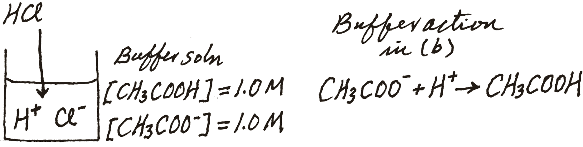
16.3
Calculate the pH of a buffer system containing 1.0 M CH₃COOH and 1.0 M CH₃COONa. The K_{a} of CH₃COOH is 1.8 x 10⁻⁵ (Table 15.3).
(b) What is the pH of the buffer system after the addition of 0.10 mole of gaseous HCl to 1.0 L of the solution?
(4.74)
0.10 M
0.10 M
 | CH₃COO⁻(aq) | + H⁺(aq) | → | CH₃COOH(aq)
Initial (mol):
Change (mol):
Final (mol):
1.0
0.10
1.0
-0.10
-0.10
+0.10
0.90
0
1.1
[0.9]
pH = -log (1.8 x 10⁻⁵) + log
= 4.66
[1.1]

Slide 25
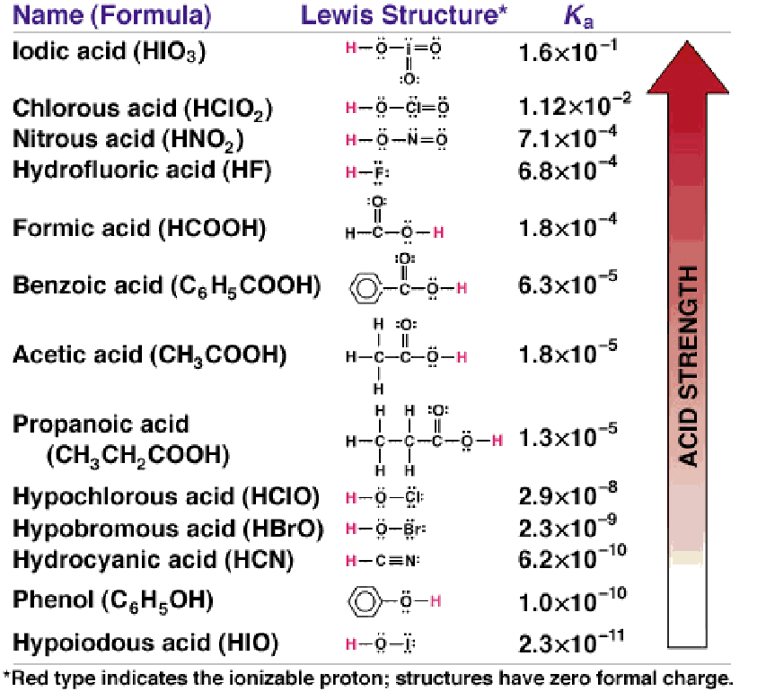
Preparing a Buffer Solution
Choose a target pH. Depends on what you want to study.
Choose the appropriate choice of a weak acid and conjugate base.
Most effective buffer when the pK_{a} is closest to the target pH.
Either:
Mix the Acid/salt in the appropriate ratio.
or
The acid and its salt are mixed in a 1 to 1 ratio.
The pH is then adjusted by adding a strong acid or base until it equals your target pH.

Slide 26
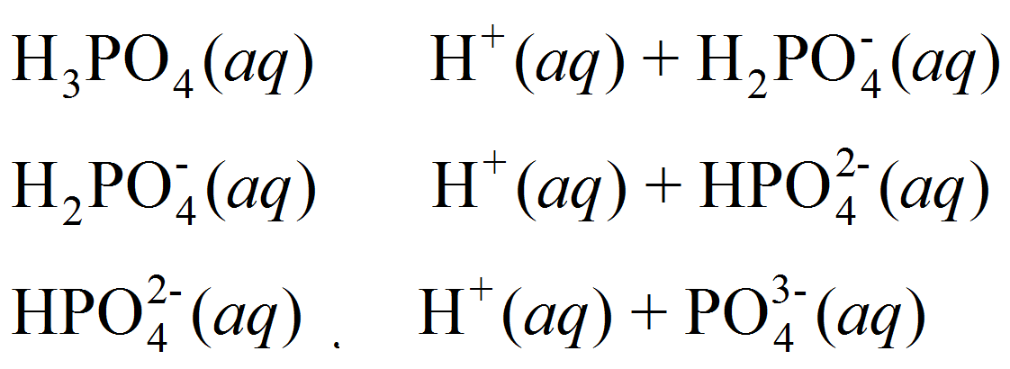
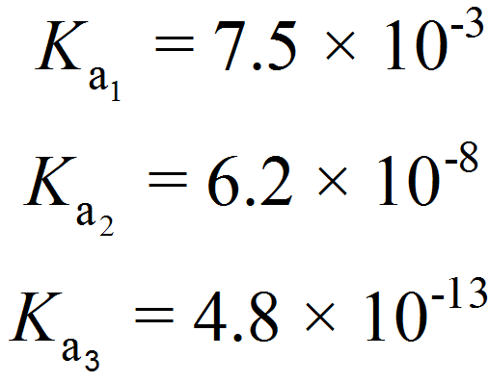
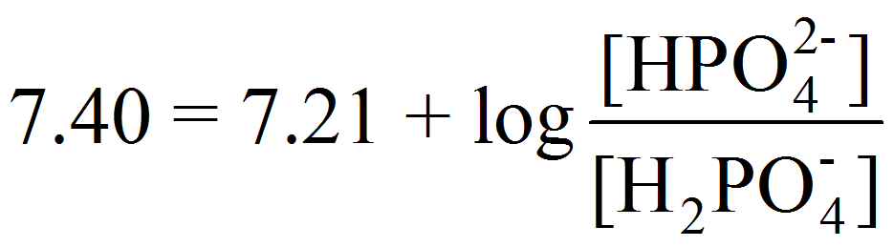
16.4
Describe how you would prepare a “phosphate buffer” with a pH of 7.40.
[A⁻]
pH = pK_{a} + log
[HA]
Known (7.40)
Find the ratio
Choose the right acid/salt
Most Effective when pH = pK_{a}
[A⁻]
7.4 = -log (6.2 x 10⁻⁸) + log
[HA]

Slide 27
16.4
Describe how you would prepare a “phosphate buffer” with a pH of 7.40.
[A⁻]
pH = pK_{a} + log
[HA]
Known (7.40)
Find the ratio
Choose the right acid/salt
Make the buffer:
Dissolve disodium hydrogen phosphate (Na₂HPO₄) and sodium dihydrogen phosphate (NaH₂PO₄) in a mole ratio of 1.5:1.0 in water.
or
Dissolve disodium hydrogen phosphate (Na₂HPO₄) and sodium dihydrogen phosphate (NaH₂PO₄) in a mole ratio of 1.0:1.0 in water. Then add 0.2 equivalence of a strong base.
[1+x]
7.40 = 7.21 + log
x = 0.2
[1-x]

Slide 28
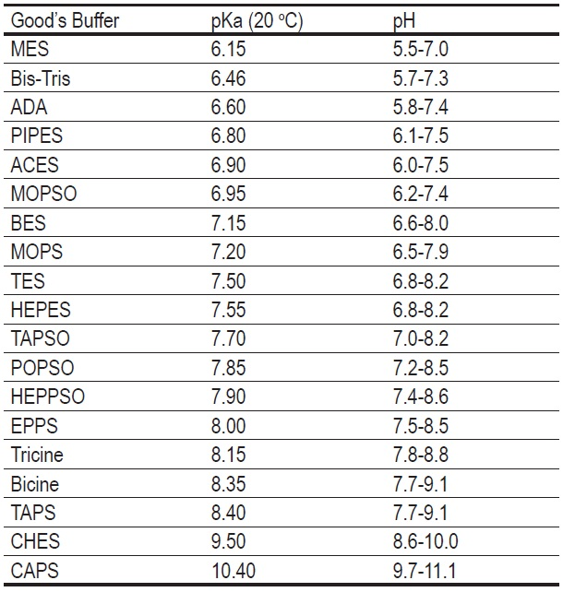
Biochem Relevant Buffers

Slide 29
Relevant Equations Summary
1) K_{w} = [H⁺][OH⁻] = 1.0 x 10⁻¹⁴
B⁻(aq) + H₂O(l) BH(aq) + OH⁻(aq)
2) pH = -log [H⁺]
[BH][OH⁻]
K_{b} =
3) pOH = -log [OH]
[B⁻]
4) pH + pOH = 14
HA_{(aq)} H⁺_{(aq)} + A⁻_{(aq)}
[H⁺][A⁻]
5) K_{a}K_{b} = K_{w}
K_{a} =
[HA]
Henderson-Hasselbalch equation
HA (aq) H⁺ (aq) + A⁻ (aq)
NaA (s) Na⁺ (aq) + A⁻ (aq)
[A⁻]
pH = pK_{a} + log
[HA]
Assumption: that the [A⁻] from NaA >> [A⁻] from HA

Slide 30
Chapter 16

Slide 31
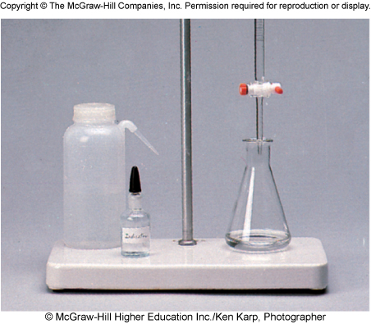
Titrations
In a titration, a solution of accurately known concentration is gradually added to another solution of unknown concentration until the chemical reaction between the two solutions is complete.
Redox titration
Complexometric indicator
Acid-base titration
Acid-Base Titration is a neutralization process aimed at adding a necessary amount of acid/H⁺ (or base/OH⁻) to a solution of base/OH⁻ (or acid/H⁺) in order to reach the equivalence point.
At the equivalence point, the number of moles of added H₃O⁺ (or OH–) ions equals the number of moles of OH– (or H₃O⁺) ions originally present.

Slide 32
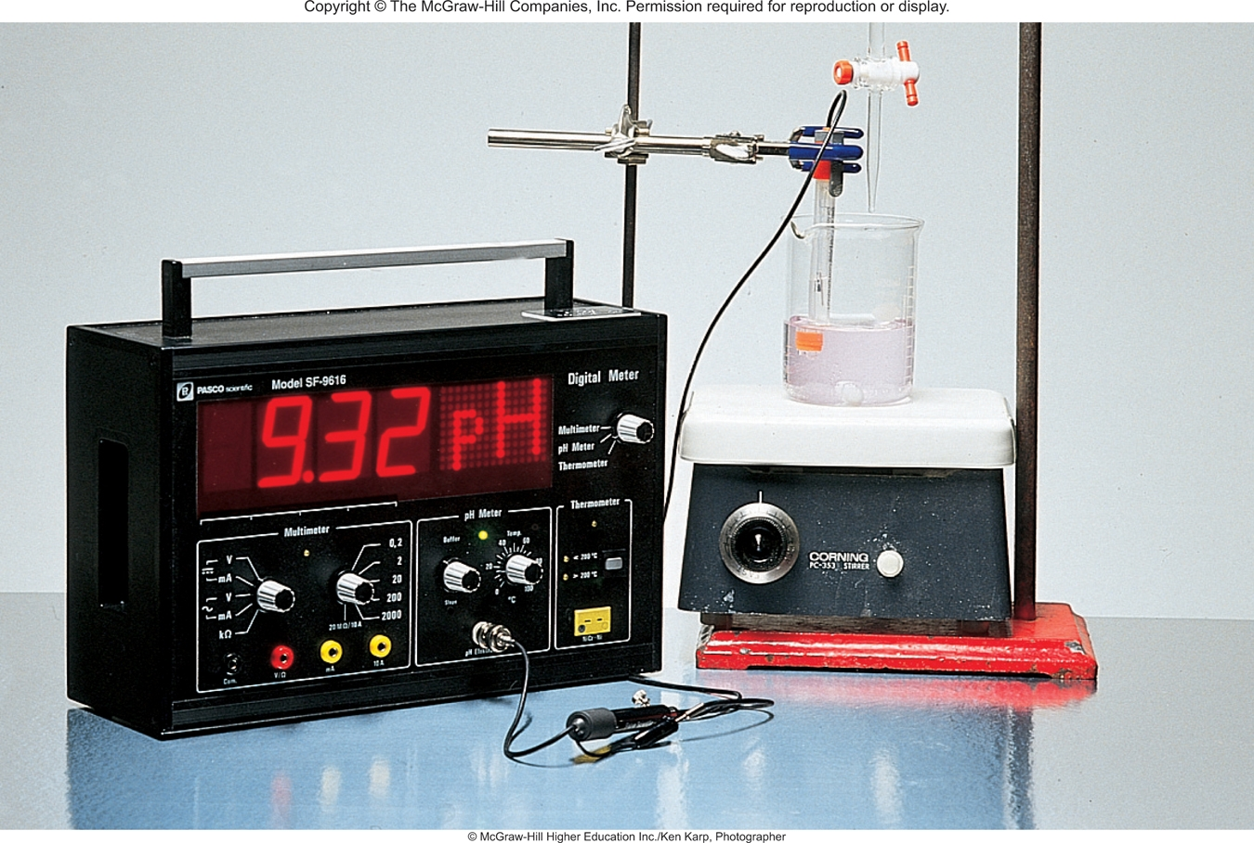
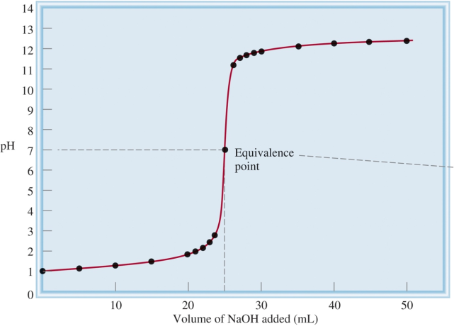
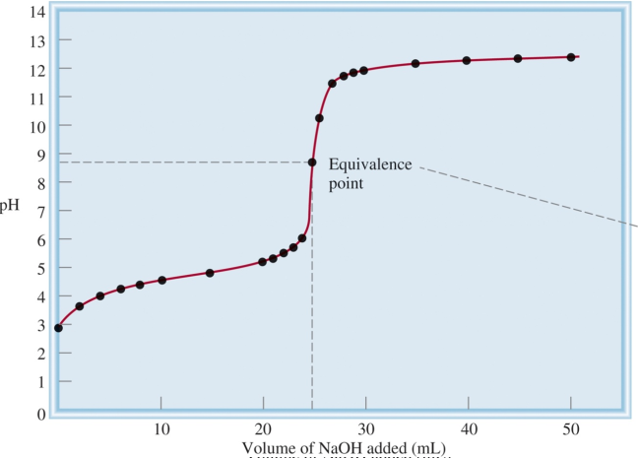
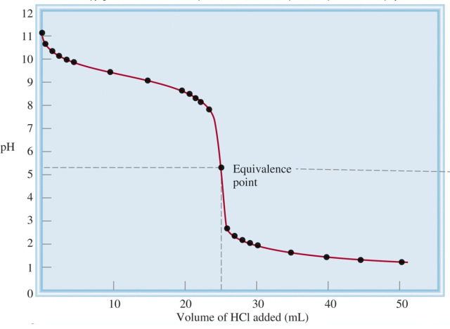
The Experiment
Start with [unknown] solution.
Add known amounts of an acid or base.
Monitor pH with respect to amount added.
Graph pH vs concentration.
Find equivalence point.
Find pK_{a} of weak acid or base.
Strong base to a strong acid.
Strong base to a weak acid.
Strong acid to a weak base.

Slide 33
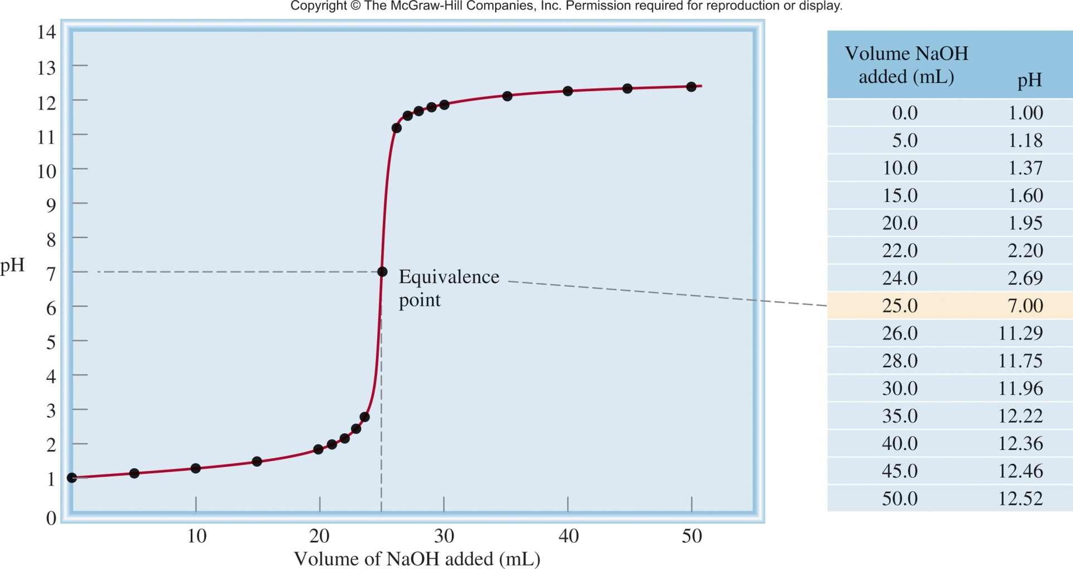
Strong base to strong acid
NaOH
HCl
NaOH (aq) + HCl (aq) H₂O (l) + NaCl (aq)
Strong means they completely dissociate.
Na⁺ + OH⁻ + H⁺ + Cl⁻ H₂O (l) + Na⁺ + Cl⁻
OH⁻ (aq) + H⁺ (aq) H₂O (l)
25.0 mL of 0.1 M HCl
adding 0.1 M NaOH

Slide 34
Strong base to strong acid
NaOH (aq) + HCl (aq) H₂O (l) + NaCl (aq)
Start with:
25.0 mL of 0.1 M HCl
Adding:
0.1 M NaOH
Since they completely react we can easily calculate the pH when:
1) After the addition of 0 mL of 0.1 M NaOH.
0.1 M HCl = 0.1 M H⁺
pH = -log [H⁺]
pH = 1

Slide 35



Strong base to strong acid
NaOH (aq) + HCl (aq) H₂O (l) + NaCl (aq)
Start with:
25.0 mL of 0.1 M HCl
Adding:
0.1 M NaOH
Since they completely react we can easily calculate the pH when:
1) After the addition of 10 mL of 0.1 M NaOH.
moles of NaOH/OH⁻
conc of HCl/H⁺ after the reaction
moles of HCl/H⁺
total volume (25 + 10 mL)

Slide 36
Strong base to strong acid
NaOH (aq) + HCl (aq) H₂O (l) + NaCl (aq)
Start with:
25.0 mL of 0.1 M HCl
Adding:
0.1 M NaOH
Since they completely react we can easily calculate the pH when:
2) After the addition of 25 mL of 0.1 M NaOH.
NaOH (aq) + HCl (aq) H₂O (l) + NaCl (aq)
25.0 mL of 0.1 M NaOH
25.0 mL of 0.1 M HCl
50.0 mL of H₂O
At the equivalence point!
K_{a} = K_{b}= [H⁺] = [OH⁻] = 1.0 x 10⁻⁷
pH = 7

Slide 37

Strong base to strong acid
NaOH (aq) + HCl (aq) H₂O (l) + NaCl (aq)
Start with:
25.0 mL of 0.1 M HCl
Adding:
0.1 M NaOH
Since they completely react we can easily calculate the pH when:
3) After the addition of 35 mL of 0.1 M NaOH.
At 25 mL, NaOH has consumed all HCl. Anything beyond 25 mL is just adding OH⁻ to water.
10 mL x 0.1 mol/L NaOH x 1L/1000 mL = 1.0 x 10⁻³ mol NaOH
= 0.0167 M NaOH
0.060 L
[NaOH]= [OH⁻] = 0.0167 M NaOH

Slide 38
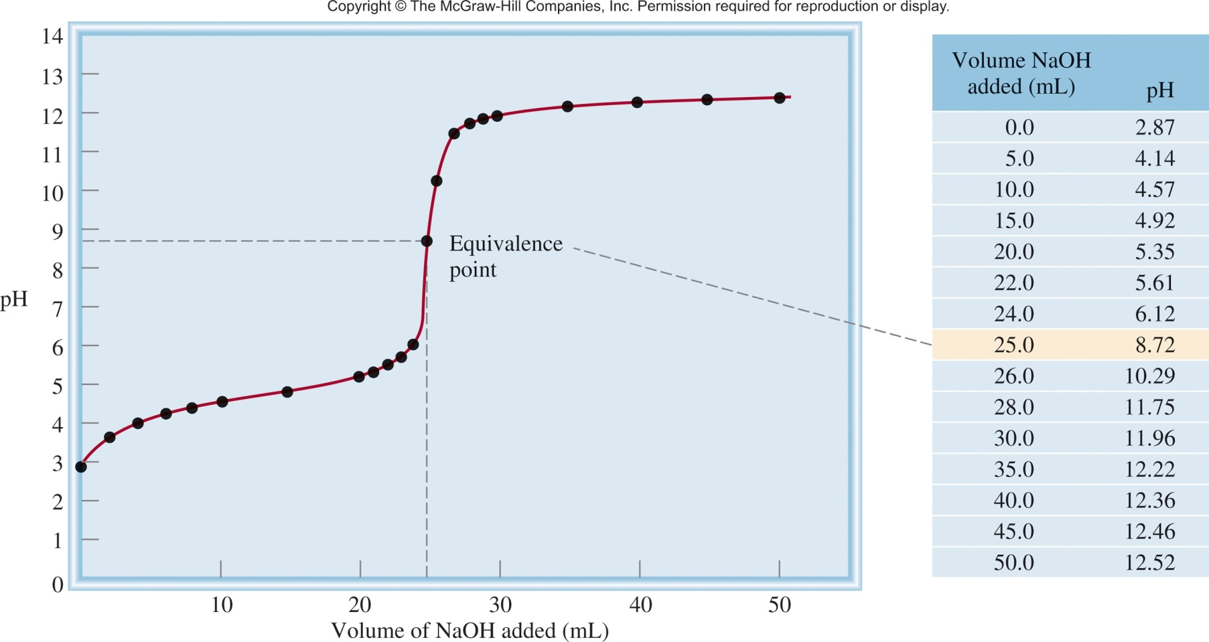
Strong base to weak acid
NaOH
CH₃COOH
CH₃COOH (aq) + NaOH (aq) CH₃COONa (aq) + H₂O (l)
CH₃COO⁻ (aq) + H₂O (l) CH₃COOH (aq) + OH⁻ (aq)
25.0 mL of 0.1 M CH₃COOH
adding 0.1 M NaOH

Slide 39
Strong base to weak acid
CH₃COOH (aq) + NaOH (aq) CH₃COONa (aq) + H₂O (l)
Start with:
25.0 mL of 0.1 M CH₃COOH
Adding:
0.1 M NaOH
Since there is an equilibrium calculating the pH is a little more difficult:
1) After the addition of 0 mL of 0.1 M NaOH.
CH₃COOH (aq) CH₃COO⁻ (aq) + H⁺ (aq)
[H⁺][A⁻]
K_{a} =
[HA]
ICE table + Math
[H⁺] = 1.3 x 10⁻³
K_{a} = 1.8 x 10⁻⁵
pH = -log (1.3 x 10⁻³) = 2.87

Slide 40
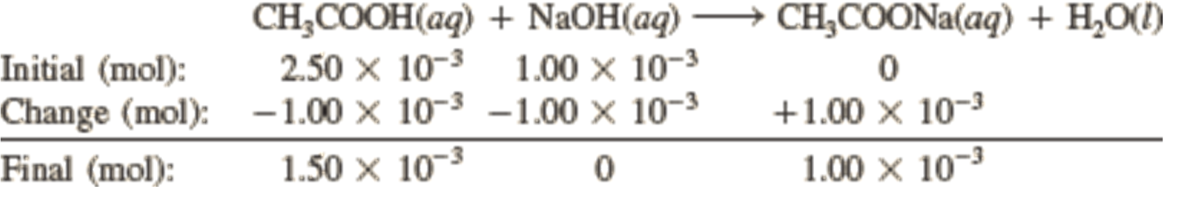
Strong base to weak acid
Start with: 25.0 mL of 0.1 M CH₃COOH
1) After the addition of 10 mL of 0.1 M NaOH.
moles of NaOH/OH⁻
moles of CH₃COOH
[A⁻]
pH = pK_{a} + log
[HA]
0.001
pH = -log (1.8 x 10⁻⁵) + log
0.0015
pH = 4.57

Slide 41
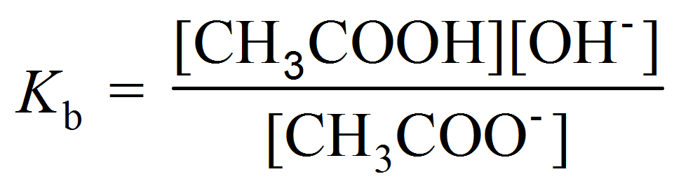
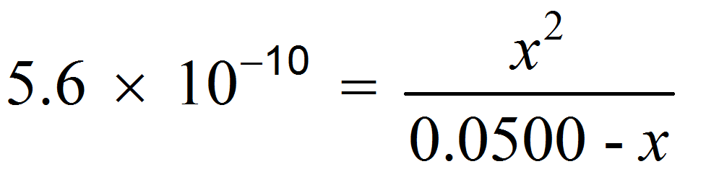
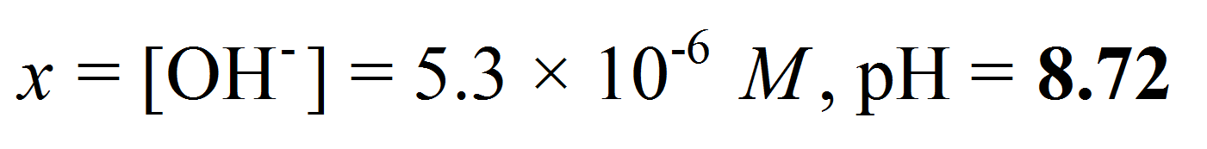
Strong base to weak acid
Start with: 25.0 mL of 0.1 M CH₃COOH
1) After the addition of 25 mL of 0.1 M NaOH.
moles of NaOH/OH⁻
moles of CH₃COOH
 | CH₃COOH (aq) | + NaOH (aq) |  | CH₃COONa(aq) | + H₂O(l)
Initial (mol): | 2.50 x 10⁻³ | 2.50 x 10⁻³ |  | 0
Change (mol): | -2.50 x 10⁻³ | -2.50 x 10⁻³ |  | +2.50 x 10⁻³
Final (mol): | 0 | 0 |  | 2.50 x 10⁻³
CH₃COO⁻ (aq) + H₂O (l) OH⁻ (aq) + CH₃COOH (aq)

Slide 42
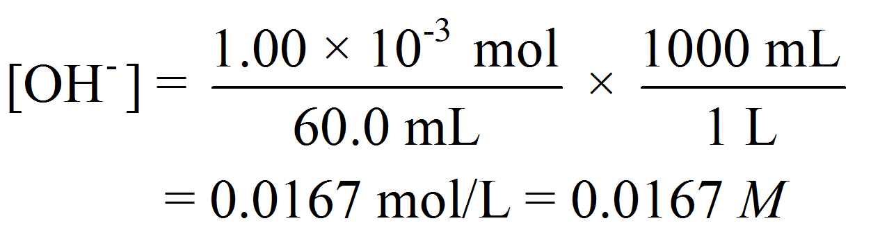
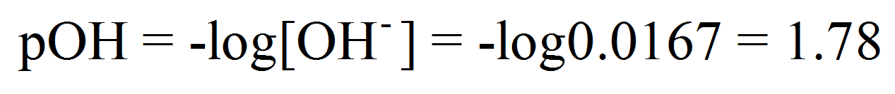
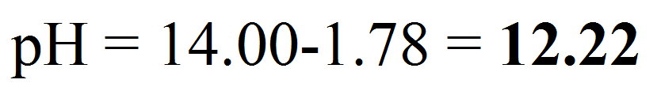
Strong base to weak acid
Start with: 25.0 mL of 0.1 M CH₃COOH
1) After the addition of 35 mL of 0.1 M NaOH.
moles of NaOH/OH⁻
moles of CH₃COOH
 | CH₃COOH (aq) | + NaOH (aq) | → | CH₃COONa(aq) | + H₂O(l)
Initial (mol): | 2.50 x 10⁻³ | 3.50 x 10⁻³ |  | 0
Change (mol): | -2.50 x 10⁻³ | -2.50 x 10⁻³ |  | +2.50 x 10⁻³
Final (mol): | 0 | 1.00 x 10⁻³ |  | 2.50 x 10⁻³

Slide 43
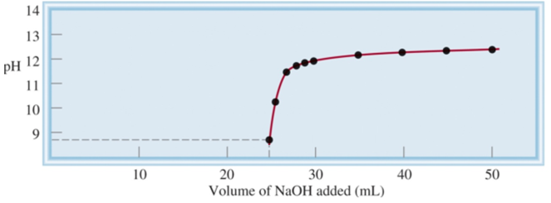
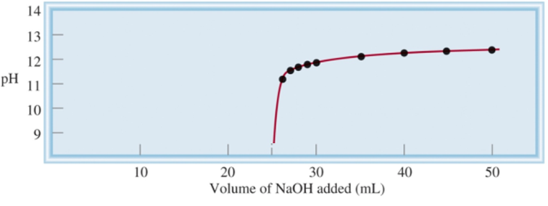
Comparison
Strong base to a strong acid.
Strong base to a weak acid.
Inflection point
= pK_{a}
Buffer Region
Strong base to a strong acid.
At high [NaOH], the pH curve is dominated by OH⁻.
Strong base to a weak acid.

Slide 44
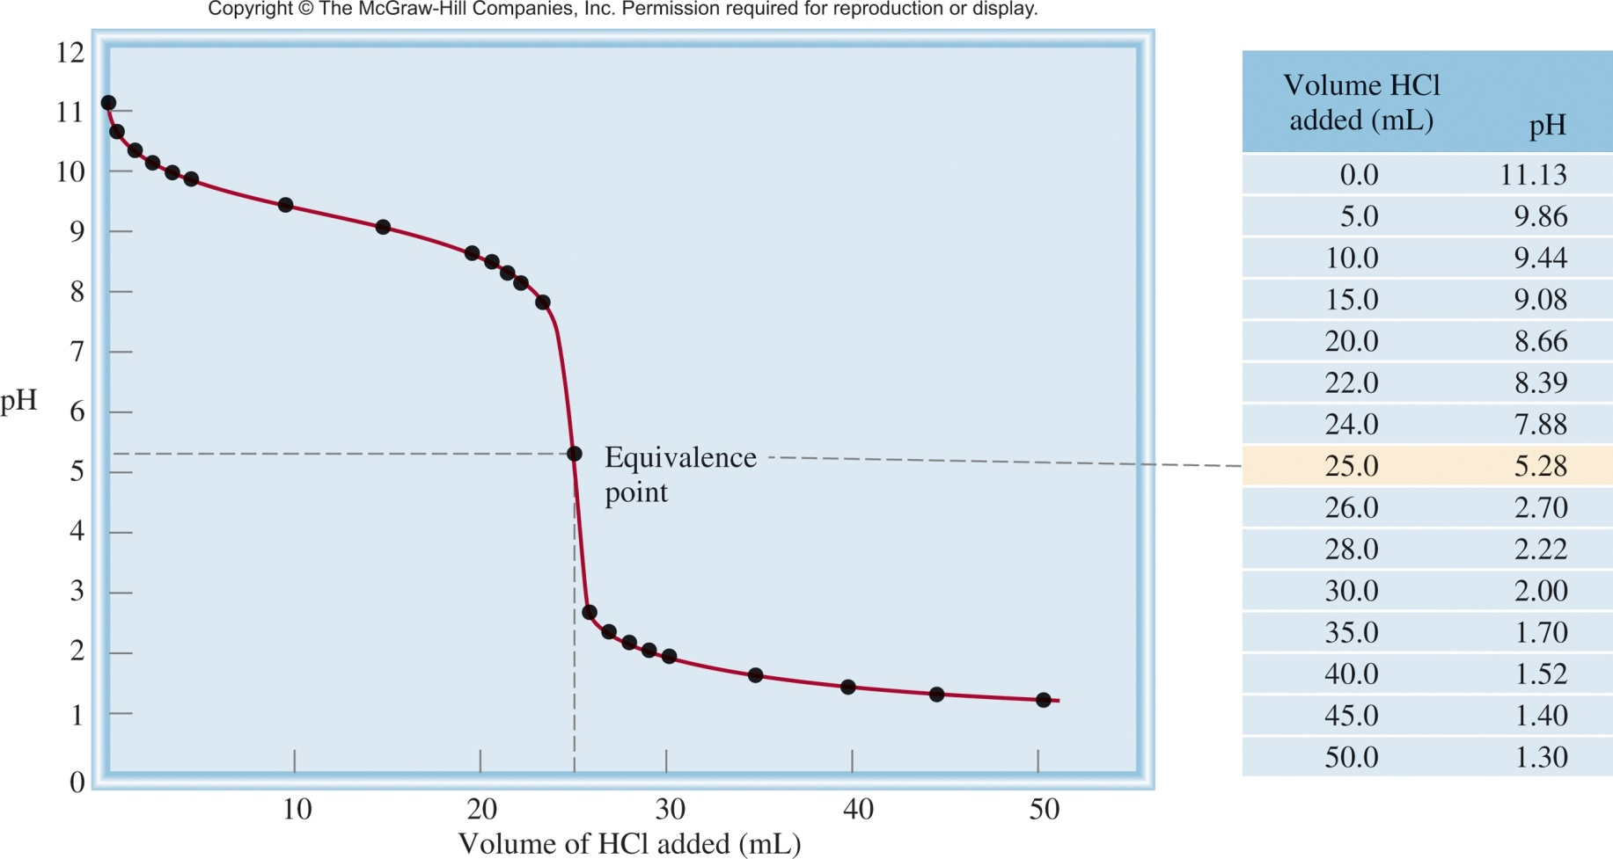
Strong acid to weak base
HCl
NH₃
HCl (aq) + NH₃ (aq) NH₄Cl (aq)
NH₄⁺ (aq) NH₃ (aq) + H⁺ (aq)
25.0 mL of 0.1 M NH₃
adding 0.1 M HCl

Slide 45
16.6
Calculate the pH at the equivalence point when 25.0 mL of 0.100 M NH₃ is titrated by a 0.100 M HCl solution.

Slide 46
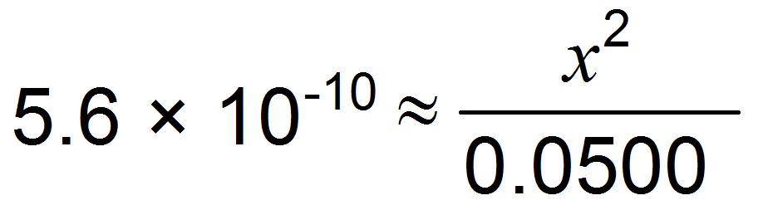
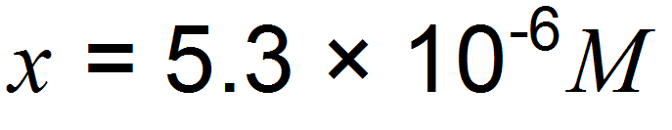
16.6
Calculate the pH at the equivalence point when 25.0 mL of 0.100 M NH₃ is titrated by a 0.100 M HCl solution.
HCl (aq) + NH₃ (aq) NH₄Cl (aq)
At equivalent point:
1
+
1
1
2.50 x 10⁻³ mol
= 0.05 M
0.05 L
 | NH4⁺(aq) |  | NH₃(aq) + | H⁺(aq)
Initial (M): | 0.0500 |  | 0.000 | 0.000
Change (M): | -x |  | +x | +x
Equilibrium (M): | (0.0500-x) |  | x | x
[0.05]
K_{a}
If > 400
we can neglect x
pH = -log (5.3 x 10⁻⁶) = 5.28

Slide 47
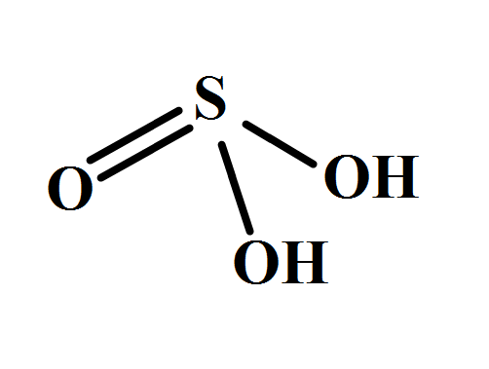
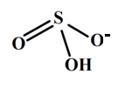

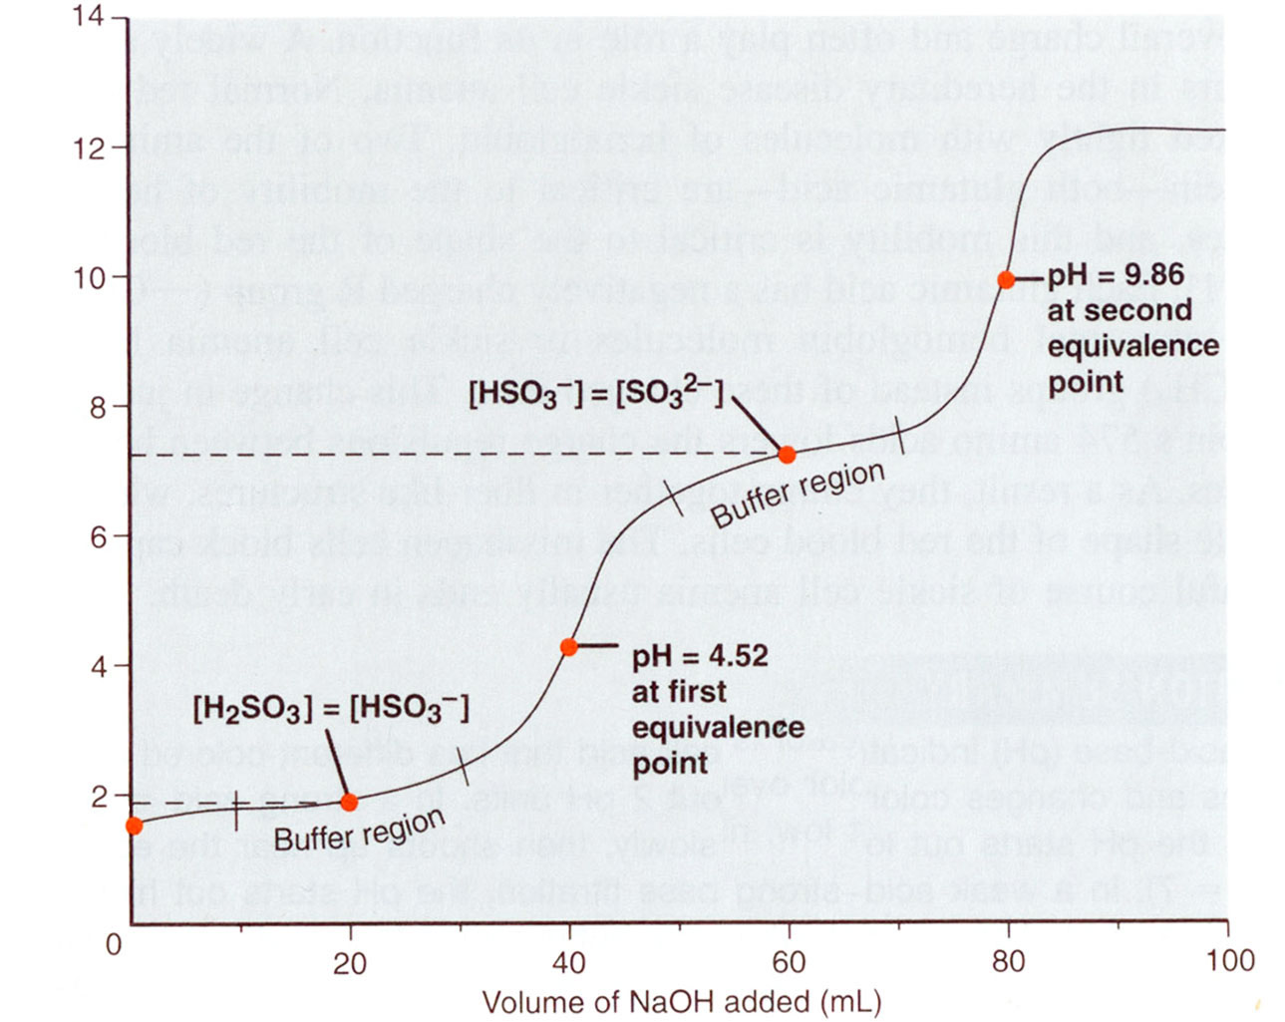
Polyprotic Acids
Titration of H₂SO₃ with NaOH
There are two buffer regions and two equivalence points corresponding to each deprotonation step.
Each of these steps involves a conjugate acid – conjugate base equilibrium.
The pH at the intermediate equivalence point depends on the pK_{a} of the corresponding species.
pK_{a2} = 7.19
pH
pK_{a1} = 1.85

Slide 48
Chapter 16

Slide 49
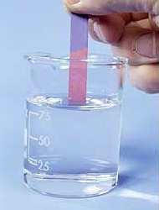
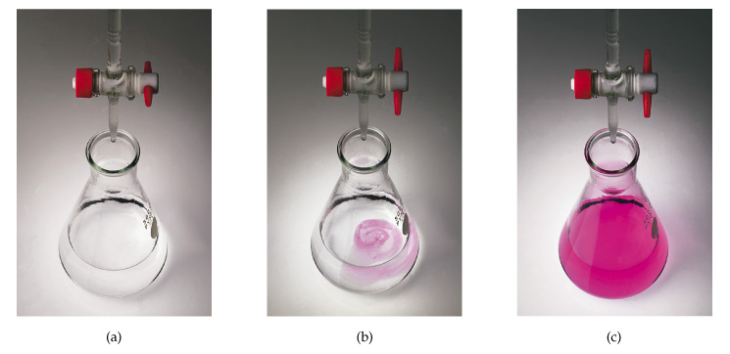
Monitoring pH
We want to know when we have reached the equivalence point.
pH Meter
pH Indicator
Strips = $0.05
>$1,500
Solution = $0.01

Slide 50
pH Indicator
Indicator – substance that changes color with respect to [H⁺]
HIn (aq) H⁺ (aq) + In⁻ (aq)
Color 1
Color 2
[HIn]
≥ 10
Color of acid (HIn) predominates
[In⁻]
[HIn]
≤ 10
Color of conjugate base (In⁻) predominates
[In⁻]
This corresponds to a change of ~2 pH units.

Slide 51
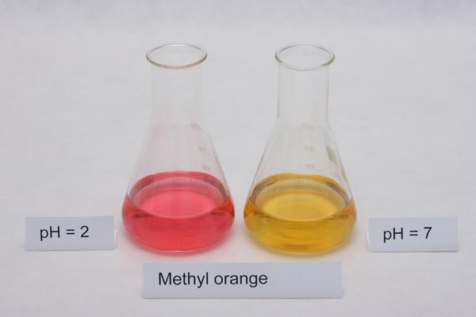
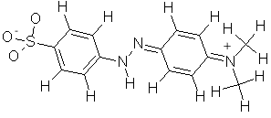
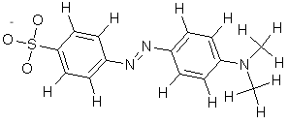
pH Indicator
Indicator – substance that changes color with respect to [H⁺]
HIn (aq) H⁺ (aq) + In⁻ (aq)
Color 1
Color 2
Add acid (H⁺) the equilibrium shifts left.
Remove H⁺ the equilibrium shifts right.
-H⁺
+H⁺
It changes from red (at pH 3.1) to orange-yellow (at pH 4.4):

Slide 52
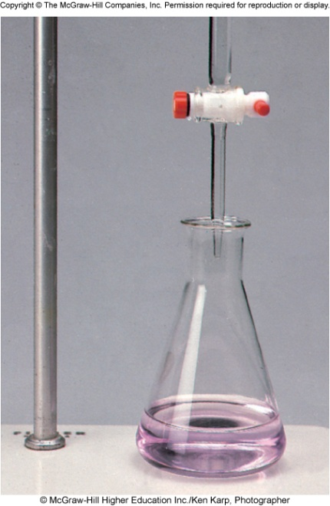
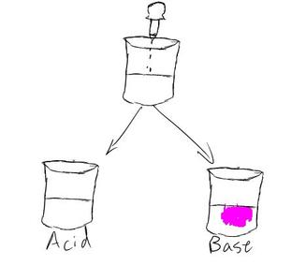
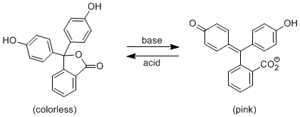
pH Indicator
Slowly add base
to unknown acid
UNTIL
the indicator
changes to pink
phenolphthalein

Slide 53
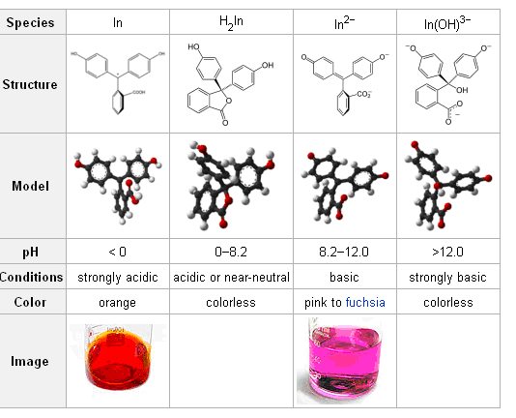
phenolphthalein

Slide 54


Bromothymol Blue
pH 5
pH 8

Slide 55
pH Indicator
Indicator – substance that changes color with respect to [H⁺]
HIn (aq) H⁺ (aq) + In⁻ (aq)
Color 1
Color 2
[HIn]
≥ 10
Color of acid (HIn) predominates
[In⁻]
[HIn]
≤ 10
Color of conjugate base (In⁻) predominates
[In⁻]
This corresponds to a change of ~2 pH units.
The key to a useful indicator for acid-base titrations is having the color change near the equivalence point.

Slide 56



Some indicators transition through several colors.
Usually composed of many color changing molecules.
pH

Slide 57




Slide 58
16.7
Which indicator or indicators would you use for the acid-base titrations here:
Near the equivalence point, the pH of the solution changes abruptly from 4 to 10. Therefore, all the indicators except thymol blue, bromophenol blue, and methyl orange are suitable for use in the titration.

Slide 59

16.7
Which indicator or indicators would you use for the acid-base titrations here:
All the indicators except thymol blue, bromophenol blue, and methyl orange are suitable for use in the titration.

Slide 60
16.7
Which indicator or indicators would you use for the acid-base titrations here:
Here the steep portion covers the pH range between 7 and 10; therefore, the suitable indicators are cresol red and phenolphthalein.

Slide 61

16.7
Which indicator or indicators would you use for the acid-base titrations here:
Phenolphthalein can be used for this titration, but methyl red will not work.

Slide 62
16.7
Which indicator or indicators would you use for the acid-base titrations here:
Here the steep portion covers the pH range between 3 and 7; therefore, the suitable indicators are methyl orange, methyl red and chlorophenol blue.

Slide 63

16.7
Which indicator or indicators would you use for the acid-base titrations here:
Here the steep portion covers the pH range between 3 and 7; methyl red is more appropriate than phenolphthalein.

Slide 64




Slide 65
Chapter 16

